Slide 1
Final Software Project
Tony Carolla
The University of Arizona Global Campus
CST 499 Capstone for Computer Software Technology
Amr Elchouemi
January 23, 2023

Slide 2
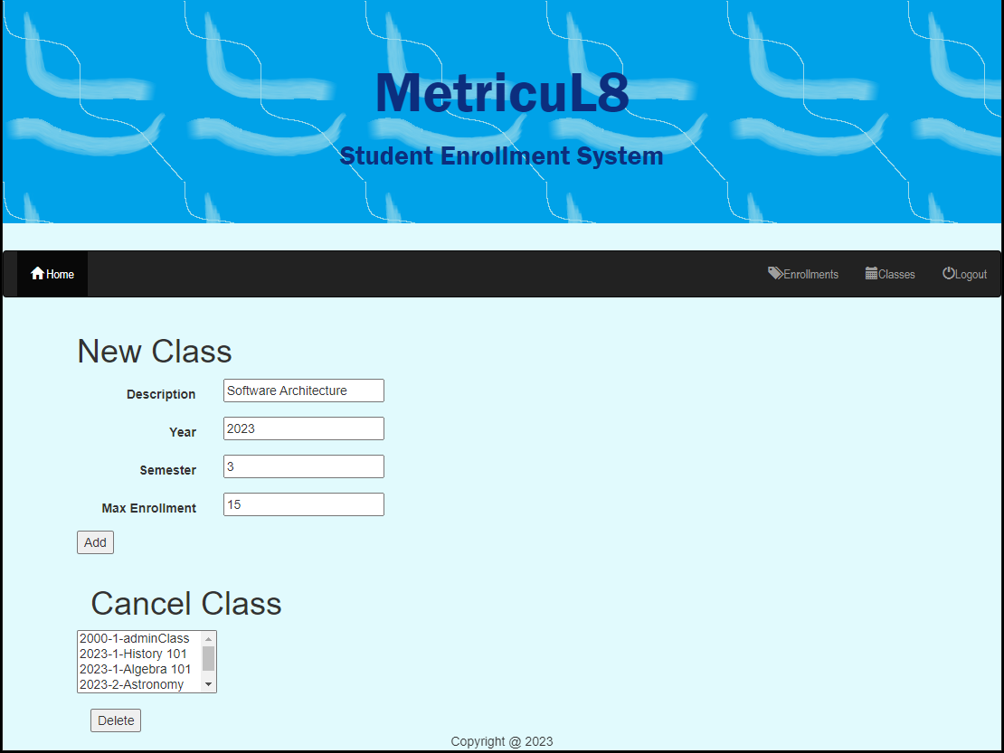
Software Requirements Specification (SRS)
Maintain Class Lists
View/Select Existing Classes
Add
Remove

Slide 3
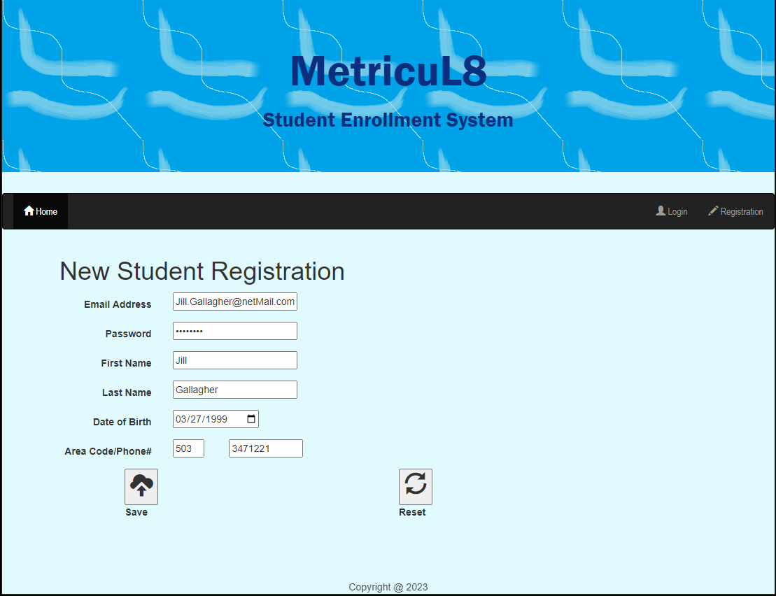
Software Requirements Specification (SRS)
Student Registration
Add

Slide 4
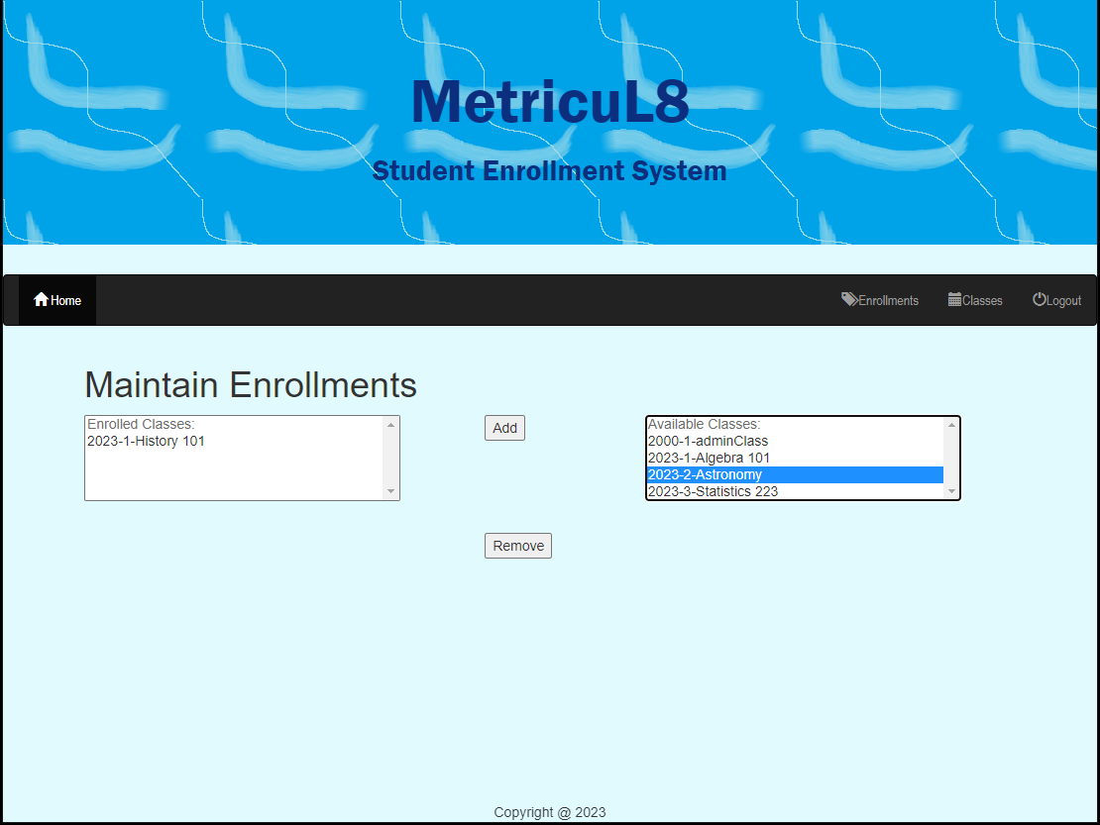
Software Requirements Specification (SRS)
Student Enrollments
Add

Slide 5
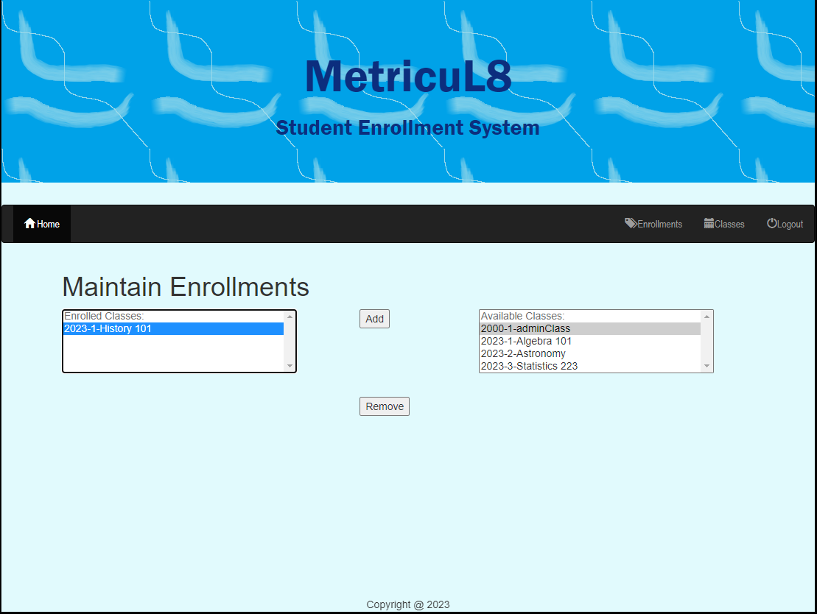
Software Requirements Specification (SRS)
Student Enrollments
Remove

Slide 6
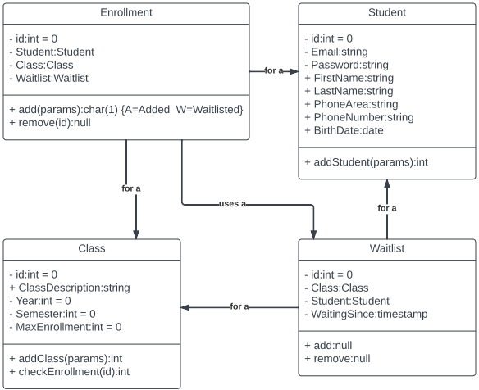
Universal Modeling Language Class Design
Tsui et al., 2018

Slide 7
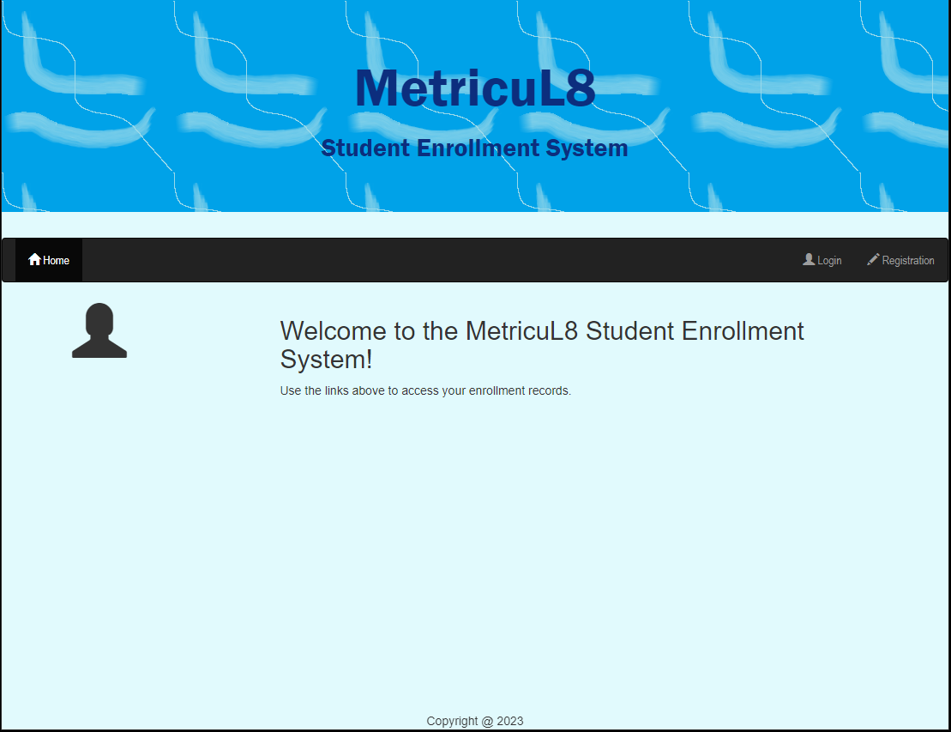
Detailed Design: Landing Page
Screen Heading
Consistent Across All Screens
Action Bar
Contextual—changes when a user logs in!

Slide 8
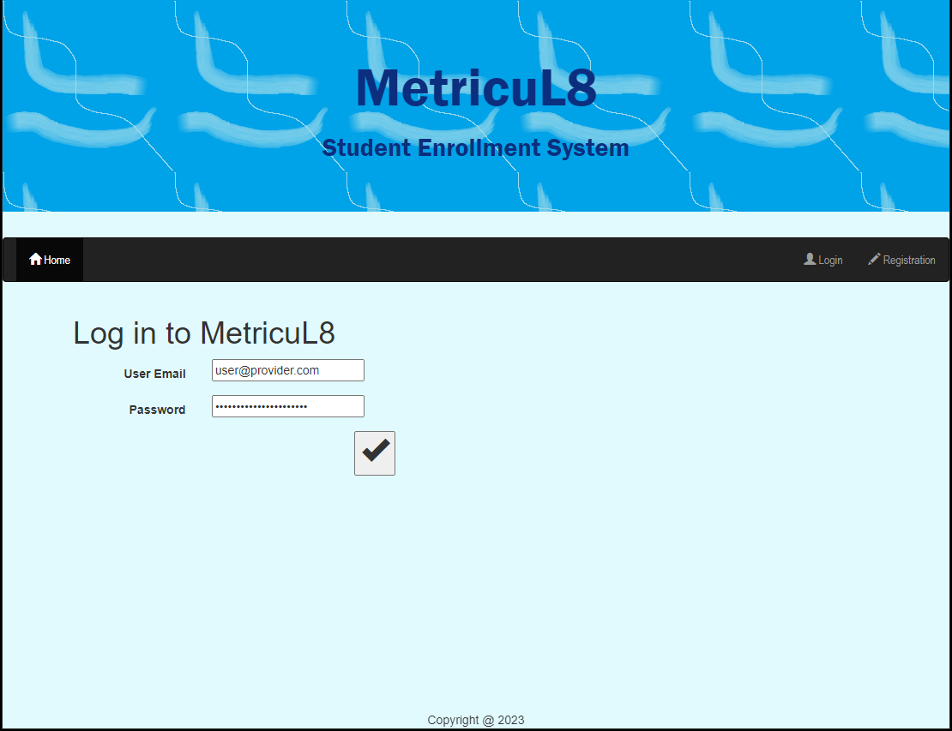
Detailed Design: Login Page
Distraction-Free Screen
Password Remains Ridden
Sent via Post for Increased Security (Tsui et al., 2018)

Slide 9
Detailed Design: Student Registration Page
Email is Primary Student ID
Password Remains Hidden
Drop-down Assistance for Date of Birth
Sent via Post for Increased Security
Tsui et al., 2018

Slide 10
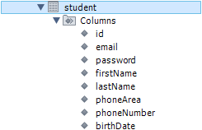
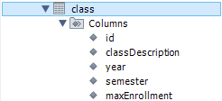


Database Review: MySQL
Kumar & Azad, 2017

Slide 11
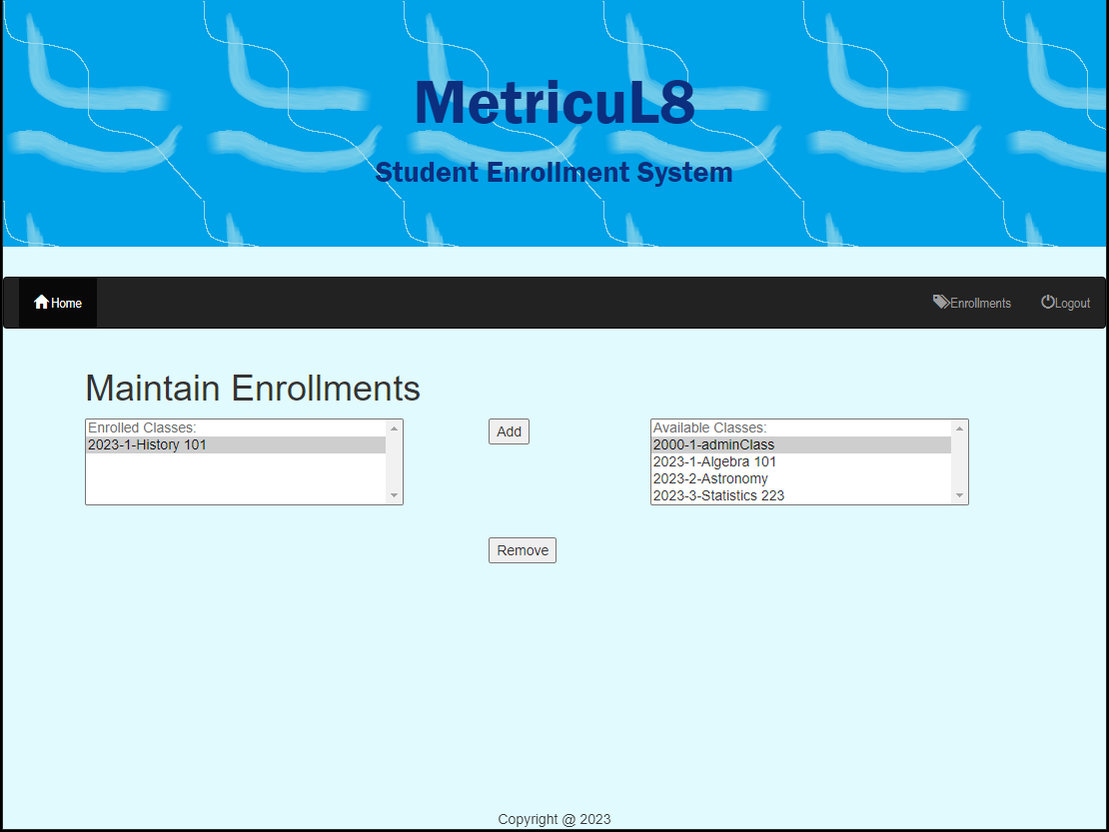
Detailed Design: Student Enrollment Page
Page Design
HTML SELECTs
User Selections Persist
POST arrays
Screen warnings
Add without selecting a class
Remove without selecting a class
Database Real-time Update

Slide 12
PHP Coding Techniques: Central DB Class
Central Database Class
No need to rewrite basic functionality in each PHP page
Most Functions Covered
executeQuery(): Runs an SQL statement and expects no result set back.
executeSelectQuery(): Runs an SQL statement and returns the result back as an array.
addClass(): Adds the specified class to the database
… more to come!
Yue, 2013

Slide 13
PHP Coding Techniques: User Choice Storage
User Choices Stored Between Page Refreshes
Alleviates data re-entry
Increases user accuracy
Stored during post, retrieved during HTML Generation
POST is detected prior to generating output
Fields are stored in PHP variables
List IDs are stored in PHP arrays
Class ID or Enrollment ID
PHP variables and arrays are echoed during HTML Generation

Slide 14
References
Kumar, K., & Azad, S. K. (2017). Database normalization design pattern. 2017 4th IEEE Uttar Pradesh Section International Conference on Electrical, Computer and Electronics (UPCON), Electrical, Computer and Electronics (UPCON), 2017 4th IEEE Uttar Pradesh Section International Conference On, 318–322. https://doi.org/10.1109/UPCON.2017.8251067
Tsui, F., Karam, O., & Bernal, B. (2018). Essentials of software engineering (4th ed.). Jones & Bartlett Learning
Yue, K.-B. (2013). Using a Semi-Realistic Database to Support a Database Course. Journal of Information Systems Education, 24(4), 327–336

